Slide 1

Scaling Up to Social Uncertainty

Slide 2


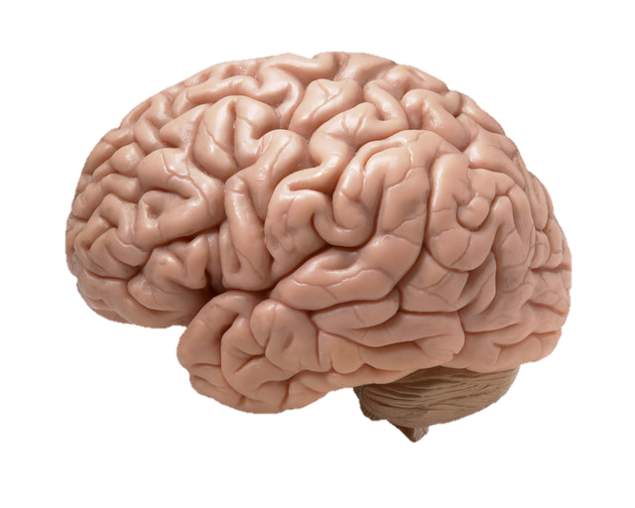
What We’ve Covered This Far

Slide 3

What We’ve Covered This Far
CELLS

Slide 4
What We’ve Covered This Far
NETWORKS
CELLS

Slide 5
What We’ve Covered This Far
FUNCTIONS
NETWORKS
CELLS

Slide 6
What We’ve Covered This Far
FUNCTIONS
NETWORKS
CELLS
PROMINENT QUESTION: HOW DO THESE SCALE?

Slide 7


What We’ve Covered This Far
FUNCTIONS
NETWORKS
CELLS
PROMINENT QUESTION: HOW DO THESE SCALE?

Slide 8


What We’ve Covered This Far
FUNCTIONS
NETWORKS
CELLS
PROMINENT QUESTION: HOW DO THESE SCALE?

Slide 9
CONTEXTS
FUNCTIONS
NETWORKS
CELLS

Slide 10


SOCIAL
DEVELOP.
CONTEXTS

Slide 11

* Note we specify ambiguity

Slide 12
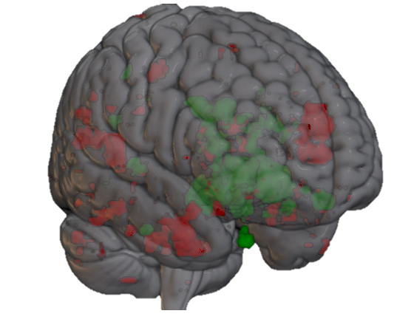
Social and non-social value judgements are represented in similar reward networks, but demonstrate distinguishable patterns of activation ¹
CUN
PFC
TP
Neurosynth.org
* Note we specify ambiguity

Slide 13
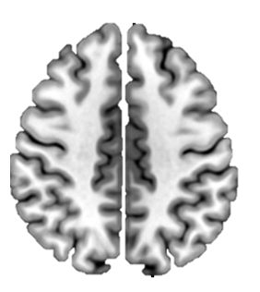
Social and non-social value judgements are represented in similar reward networks, but demonstrate distinguishable patterns of activation ¹
Assessing non-social ambiguity* recruits Intraparietal Sulcus ²
CUN
PFC
TP
* Note we specify ambiguity
Neurosynth.org

Slide 14
Social and non-social value judgements are represented in similar reward networks, but demonstrate distinguishable patterns of activation ¹
Assessing non-social ambiguity* recruits Intraparietal Sulcus ²
CUN
PFC
TP
While assessing social ambiguity recruits Inferior Frontal Gyrus, ventrolateral Prefrontal Cortex, and Anterior Insula³
Neurosynth.org

Slide 15
Assessing non-social ambiguity* recruits Intraparietal Sulcus ²
Differences may stem from differences in stimulus features & subjective goals ⁴
While assessing social ambiguity recruits Inferior Frontal Gyrus, ventrolateral Prefrontal Cortex, and Anterior Insula³

Slide 16
Assessing non-social ambiguity* recruits Intraparietal Sulcus ²
While assessing social ambiguity recruits Inferior Frontal Gyrus, ventrolateral Prefrontal Cortex, and Anterior Insula³
Differences may stem from differences in stimulus features & subjective goals ⁴

Slide 17



Assessing non-social ambiguity* recruits Intraparietal Sulcus ²
While assessing social ambiguity recruits Inferior Frontal Gyrus, ventrolateral Prefrontal Cortex, and Anterior Insula³
Differences may stem from differences in stimulus features & subjective goals ⁴

Slide 18



Assessing non-social ambiguity* recruits Intraparietal Sulcus ²
While assessing social ambiguity recruits Inferior Frontal Gyrus, ventrolateral Prefrontal Cortex, and Anterior Insula³
Differences may stem from differences in stimulus features & subjective goals ⁴

Slide 19
Assessing non-social ambiguity* recruits Intraparietal Sulcus ²
While assessing social ambiguity recruits Inferior Frontal Gyrus, ventrolateral Prefrontal Cortex, and Anterior Insula³
Differences may stem from differences in stimulus features & subjective goals ⁴

Slide 20
Assessing non-social ambiguity* recruits Intraparietal Sulcus ²
While assessing social ambiguity recruits Inferior Frontal Gyrus, ventrolateral Prefrontal Cortex, and Anterior Insula³
Differences may stem from differences in stimulus features & subjective goals ⁴

Slide 21






Responses to ambiguity (aversion) change throughout early development
and do not reach maturation until about 23 years of age ⁵
This is not the case for risk, which can be relatively stable ⁶
7
8
9

Slide 22

Responses to ambiguity (aversion) change throughout early development
and do not reach maturation until about 23 years of age ⁵
This is not the case for risk, which can be relatively stable ⁶
7
8
10

Slide 23
Assessments of uncertainty develop over time ¹¹

Slide 24





Assessments of uncertainty develop over time ¹¹

Slide 25

Assessments of uncertainty develop over time ¹¹
12

Slide 26
Assessments of uncertainty develop over time ¹¹
Assessments of uncertainty grow more sensitive as we age ¹³

Slide 27


Assessments of uncertainty develop over time ¹¹
Assessments of uncertainty grow more sensitive as we age ¹³
Assessments of uncertainty also better calibrate to objective empirical markers as we age ¹⁴

Slide 28
Assessments of uncertainty develop over time ¹¹
Assessments of uncertainty grow more sensitive as we age ¹³
Assessments of uncertainty also better calibrate to objective empirical markers as we age ¹⁴

Slide 29
Thanks to Brett!

